Slide 1
CAR PRICE PREDICTION
Car Price is one of the key factor for car owner. Some cars with good brand names seems to be of good value in the market and some may have not that much value in sale market. Its a problem for the car owner or company that some cars are more in demand and some are not.

Slide 2
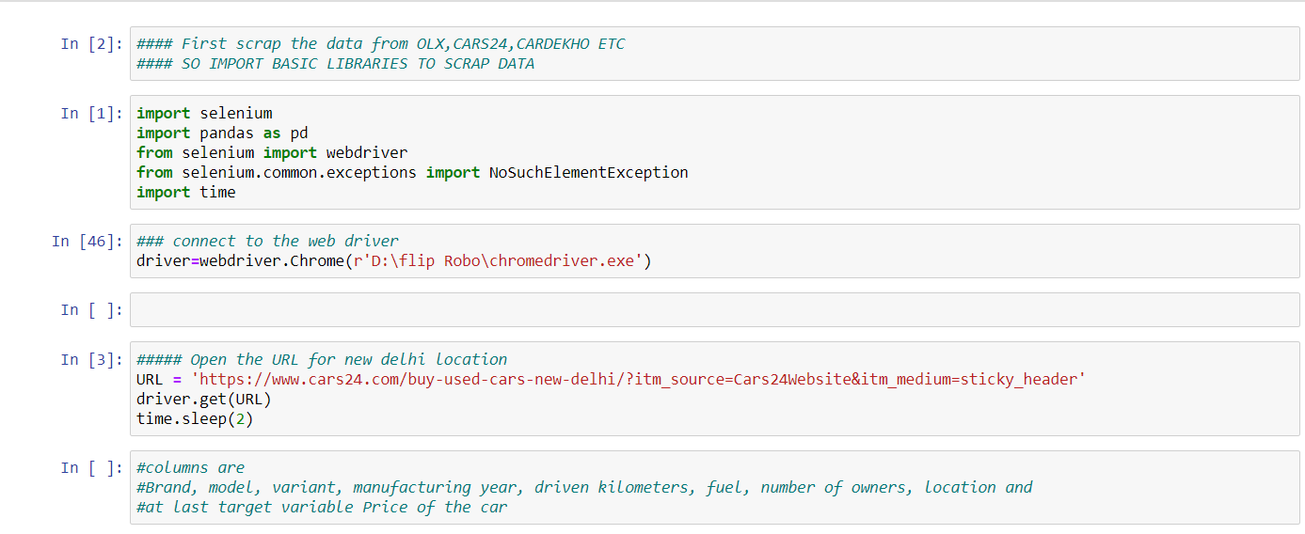
Scrapping
I have scrapped the data from cars.com of different location.

Slide 3
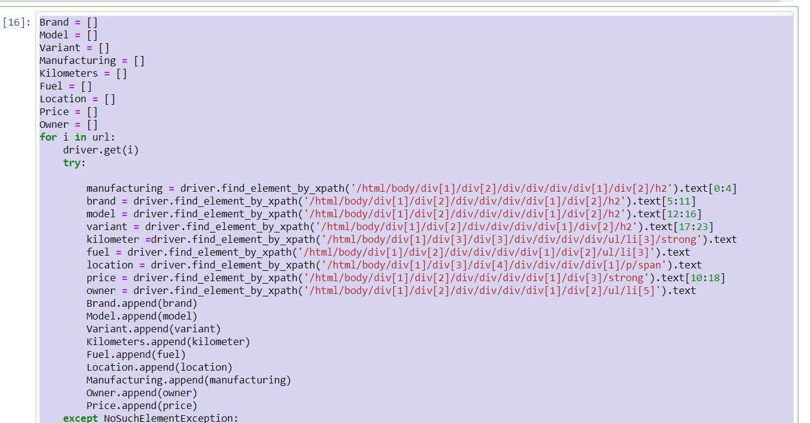
Store data in different columns

Slide 4
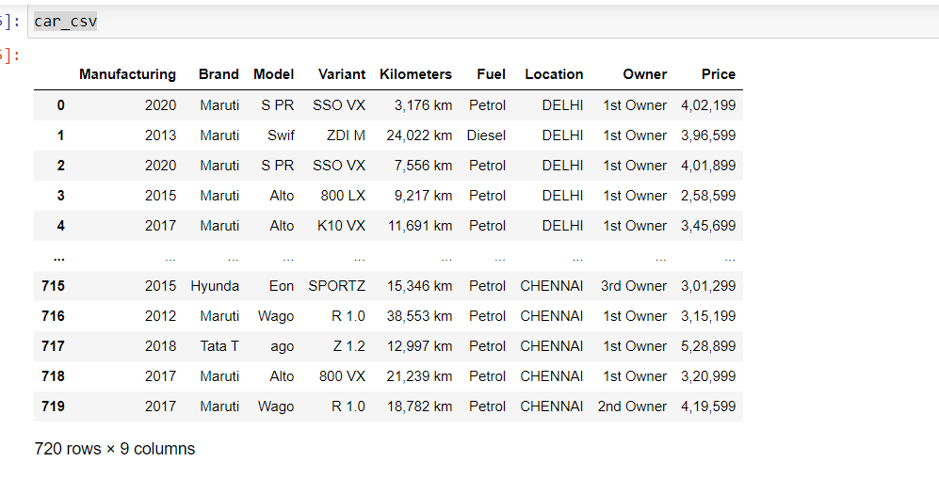
Final CSV file

Slide 5
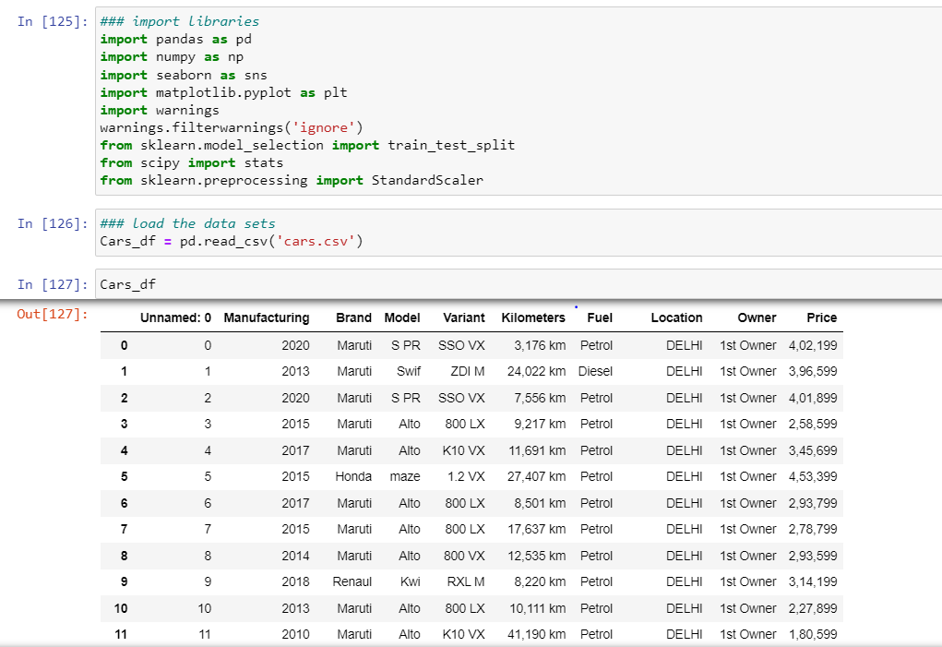
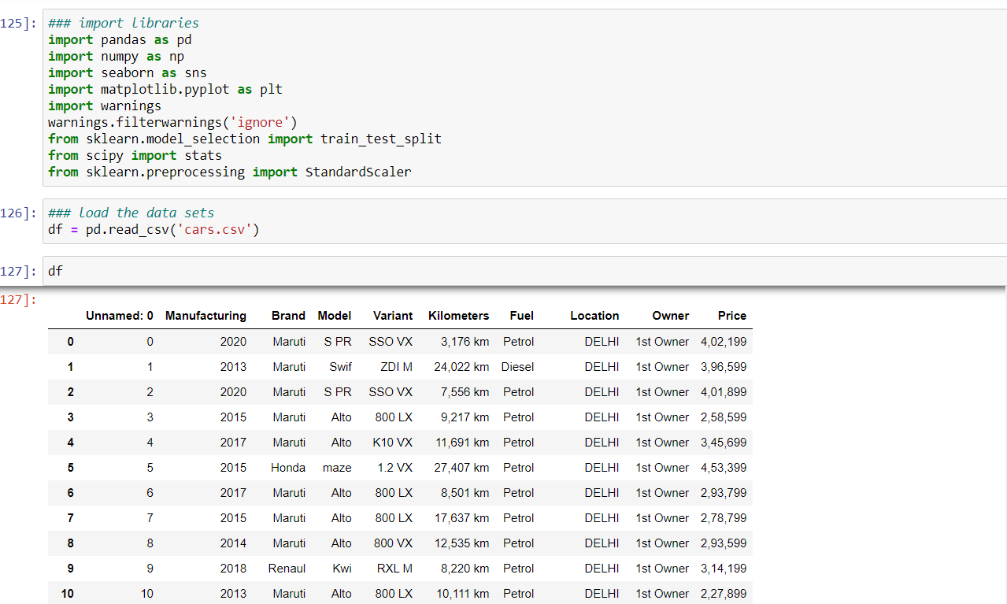
Import the libraries and load the data

Slide 6
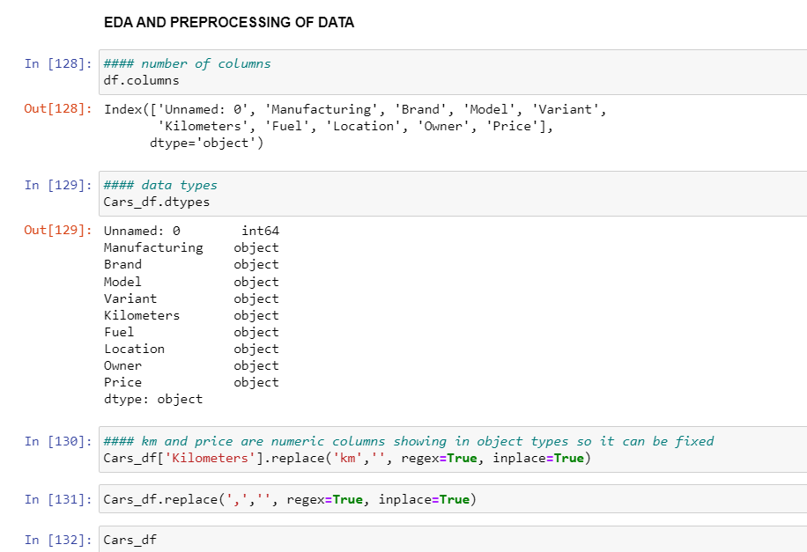
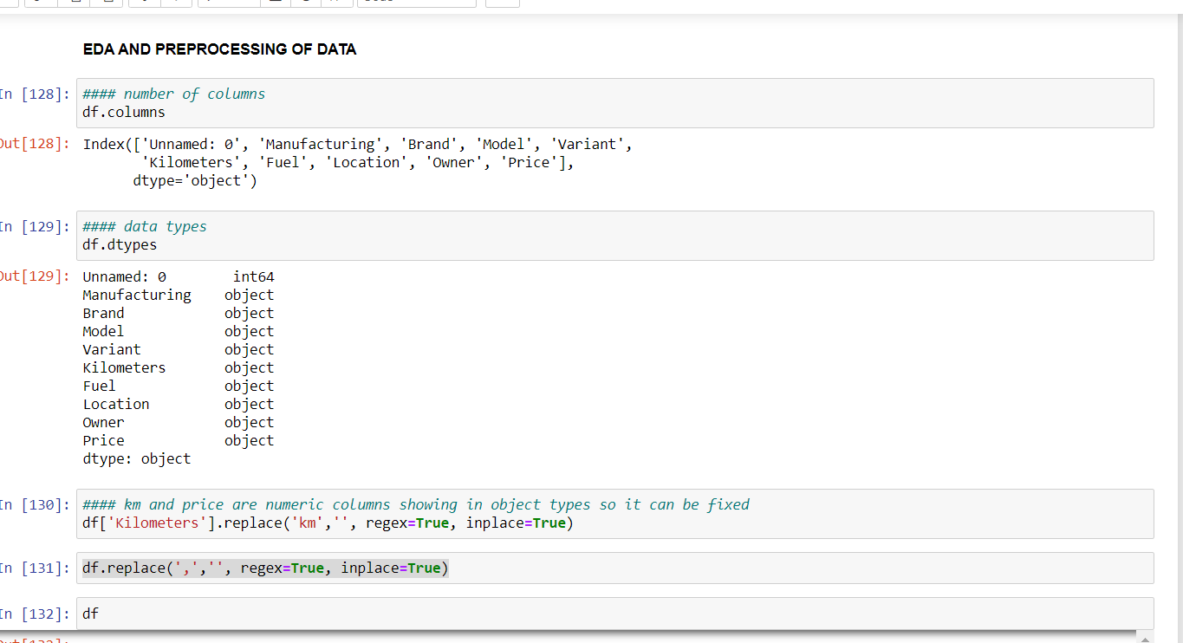
EDA and Pre-processing
EDA is the most important part of data as it shows the columns ,num of null values , value counts ,datatypes, statistical summary etc.

Slide 7
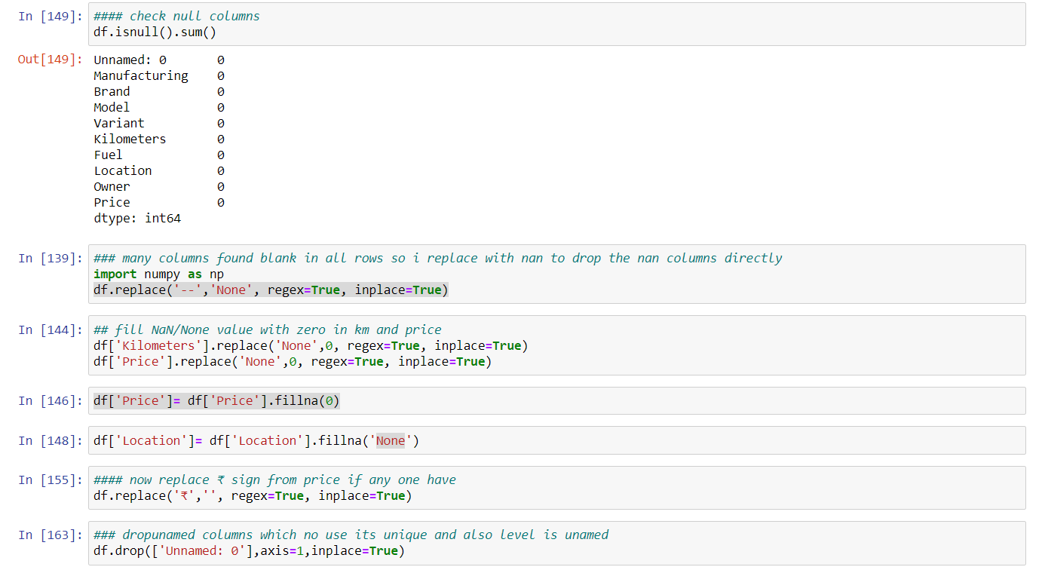
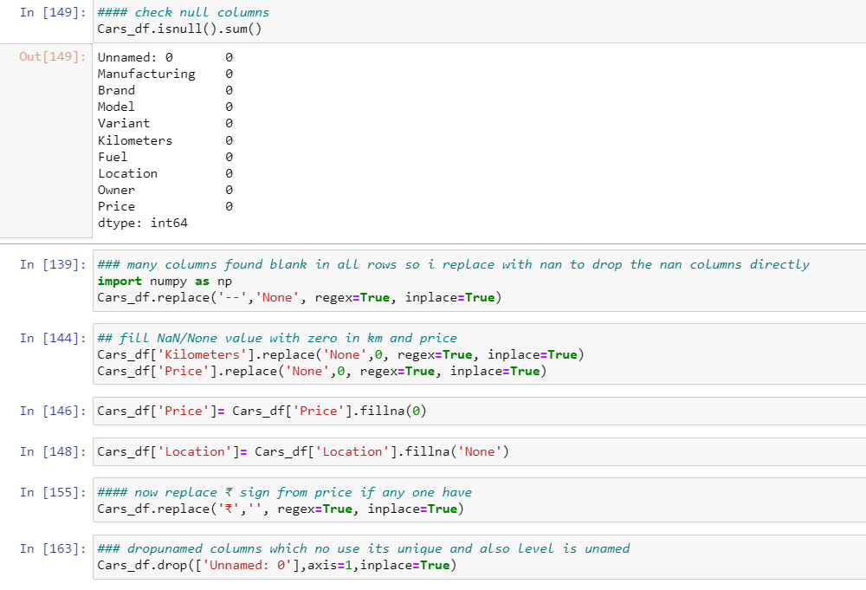
Pre-processing
Through pre-processing techniques cleanliness of data is done.

Slide 8
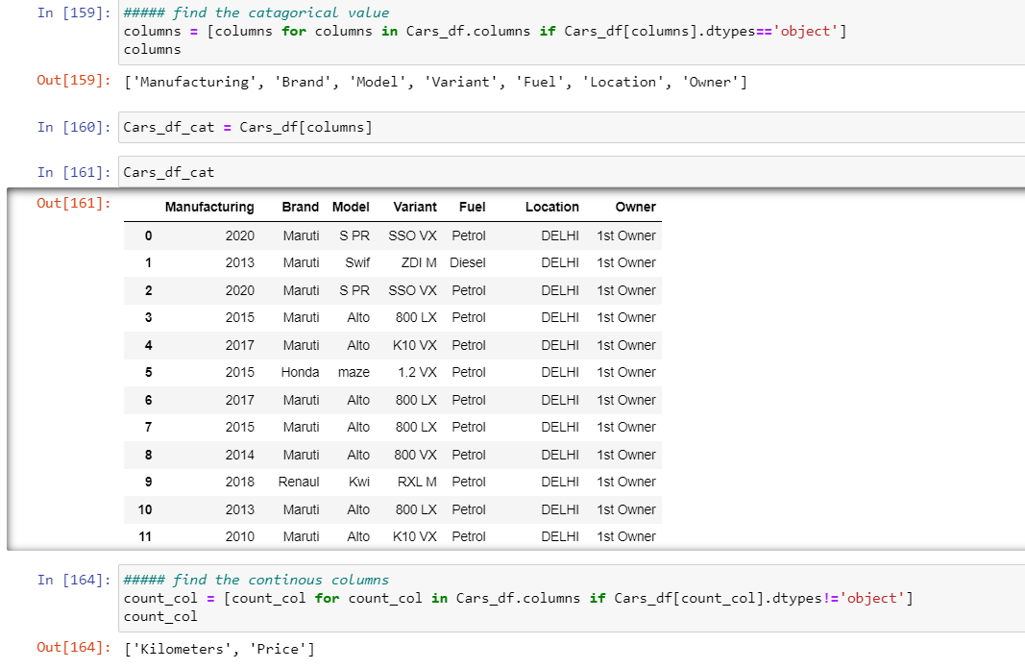
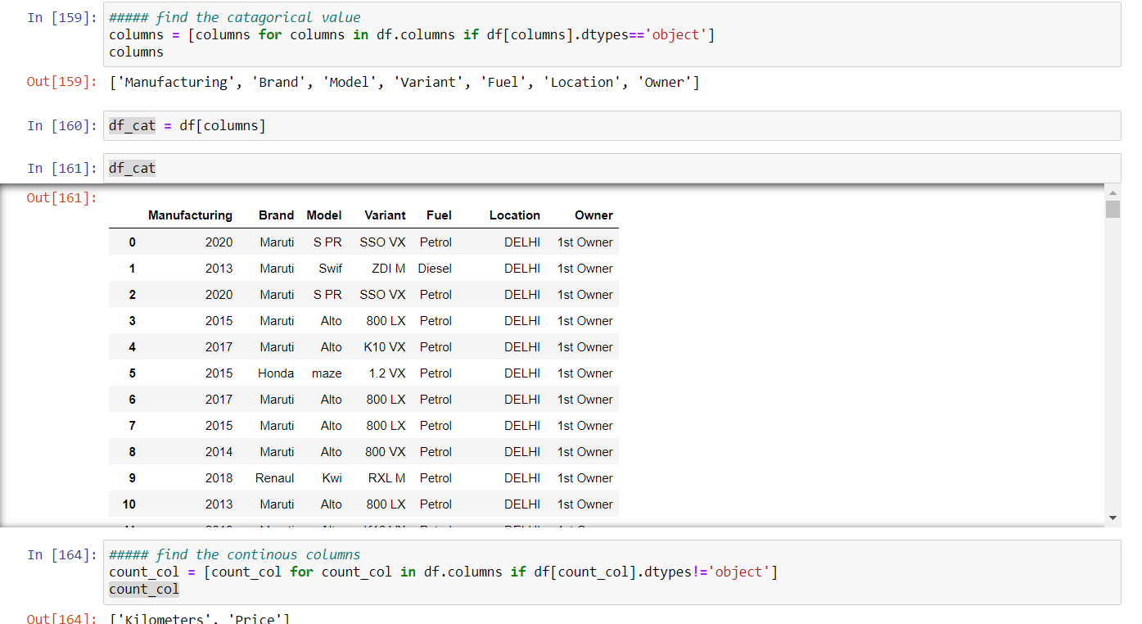
Separate the data into categorical and continuous columns and its help to keep original data safe and any mistake not lose of original one and also I can use encoding techniques as per columns

Slide 9
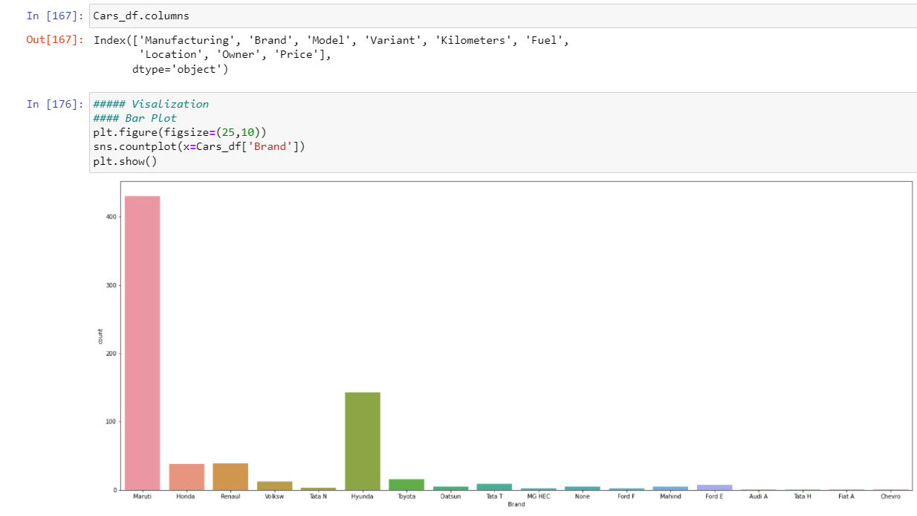
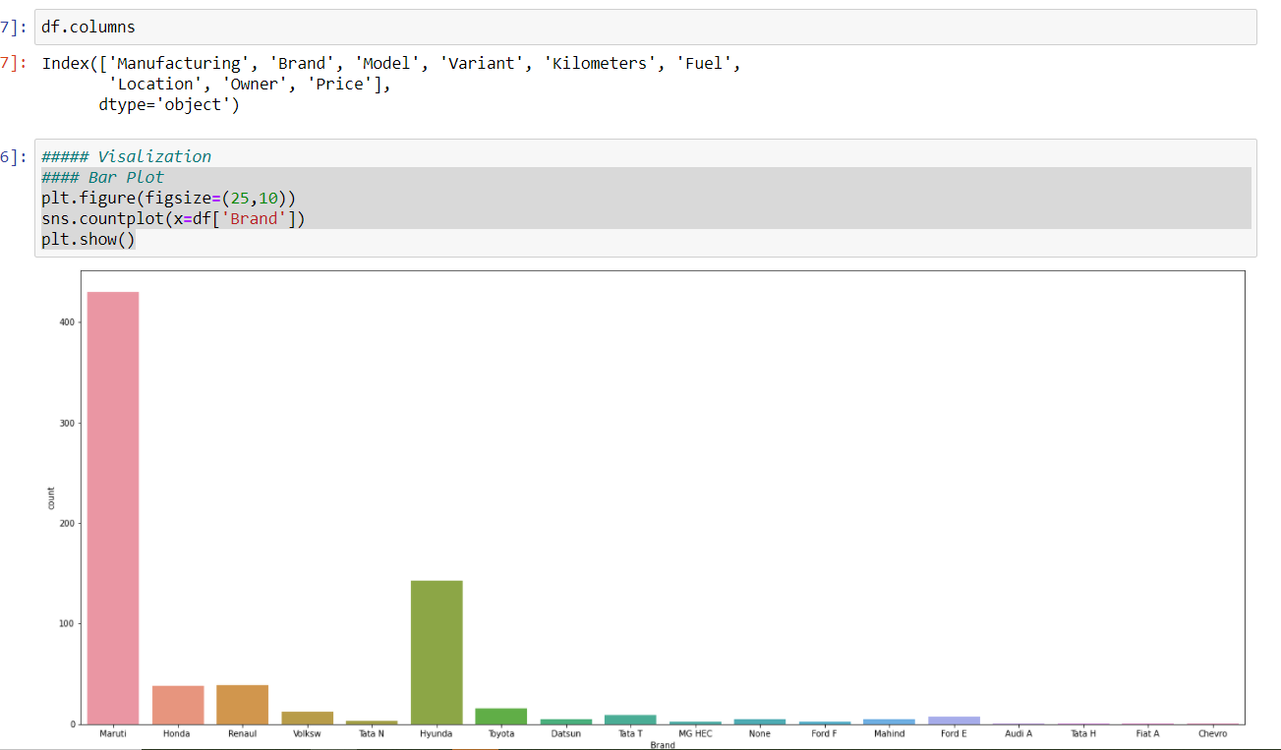
Visualization of data

Slide 10
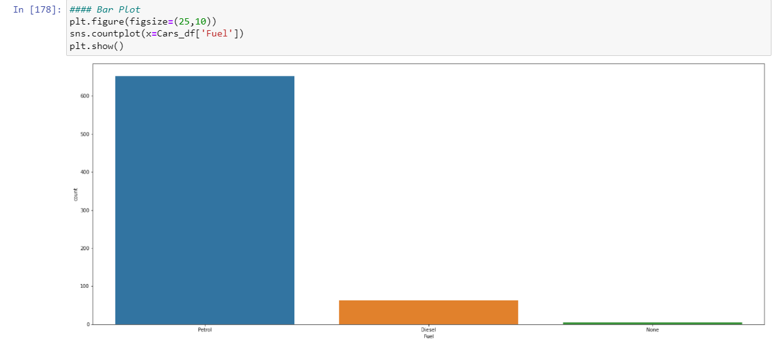
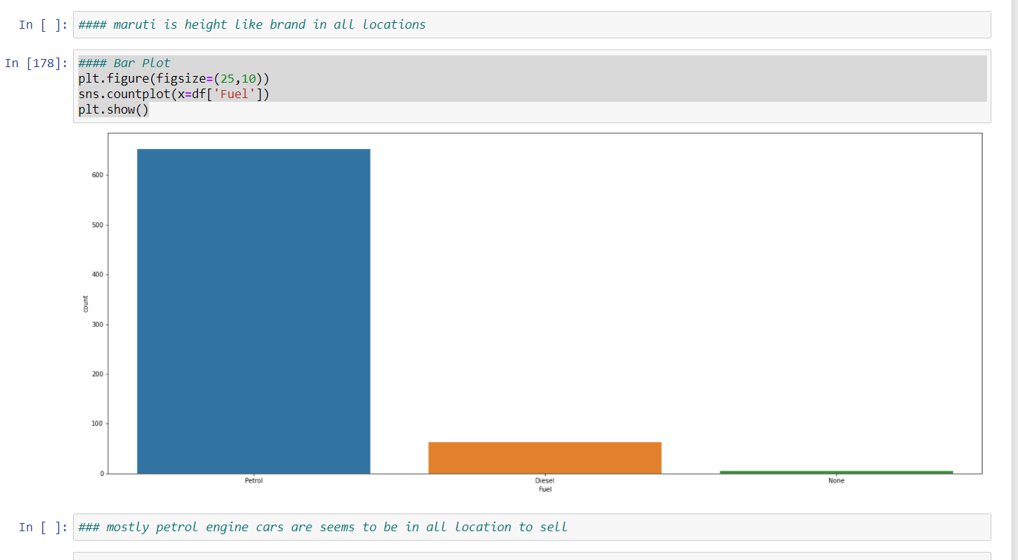
Maruti is highest selling used car and mostly petrol type car is on sale as per chart

Slide 11
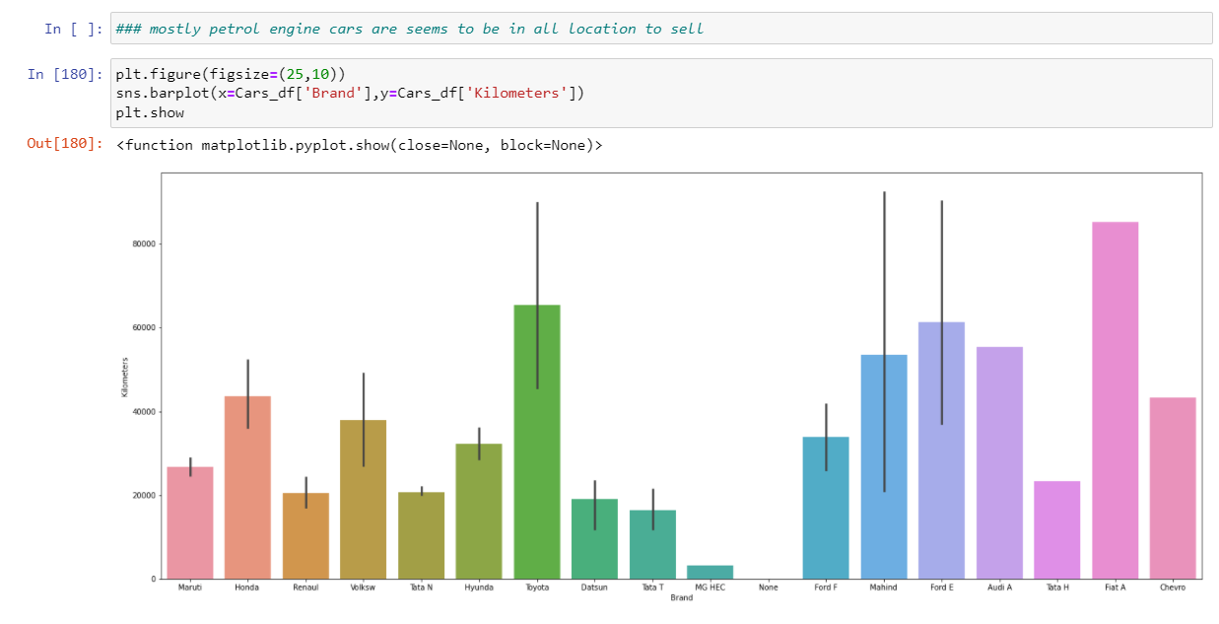
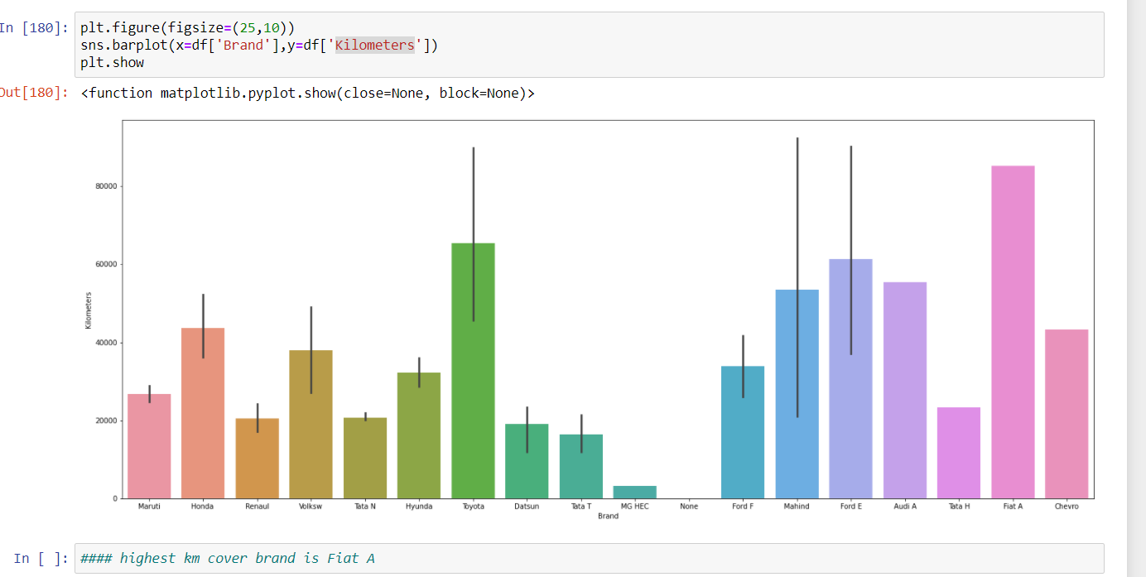

Slide 12
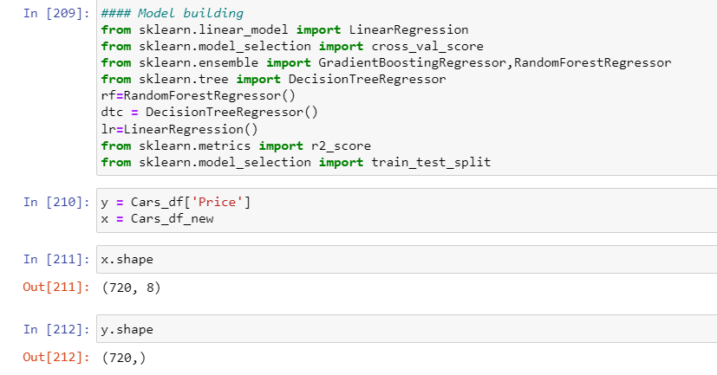
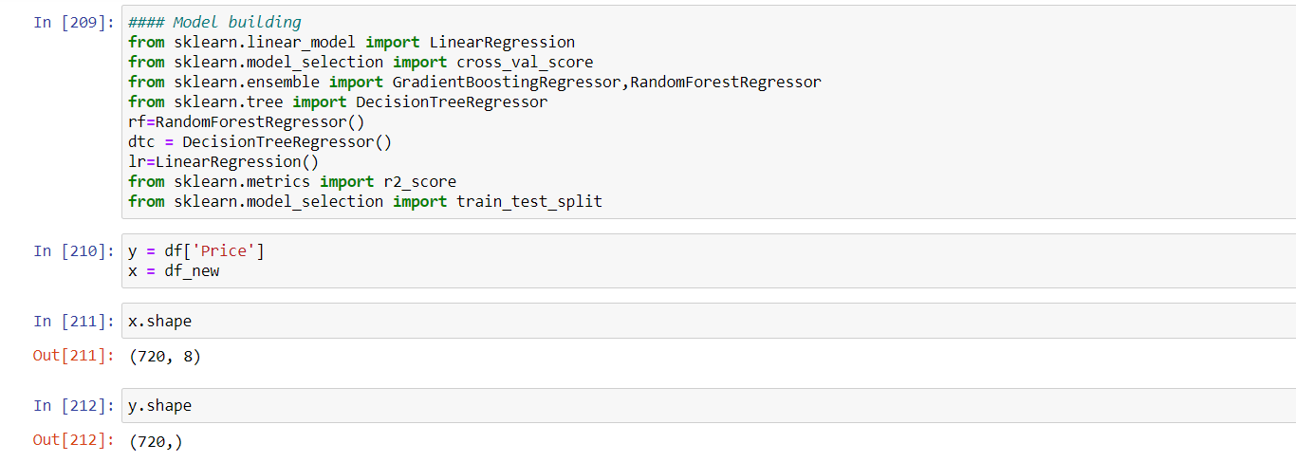
Model Building

Slide 13
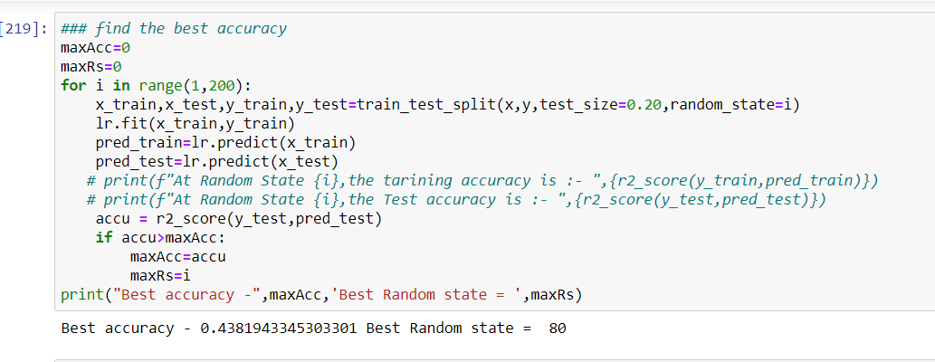
Random State

Slide 14
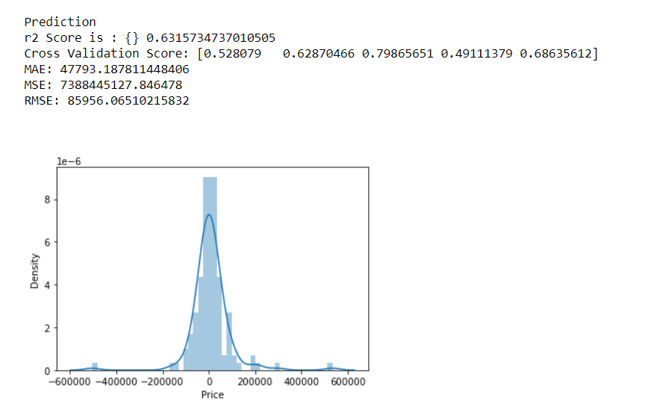
Best Model

Slide 15
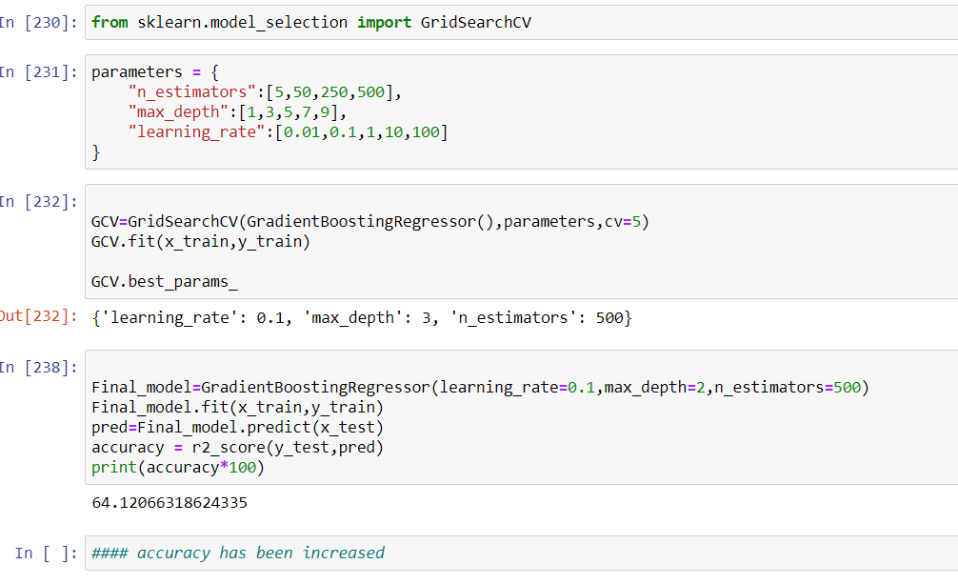
Hyper parameter tunning increase the accuracy

Slide 16
THANKYOU

